Slide 1
Anaka : Efficient Prediction of Time-Based Events using Parallel Computing Architecture.
Team : Ankit Sirmorya, Preethu Thomas, Shantanu Kande, Sumeet Pande

Slide 2

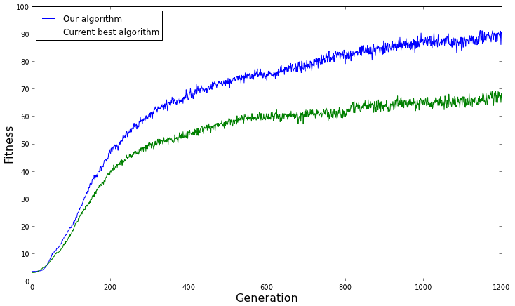
Project Objectives
Primary objective of the project is fast and efficient prediction of time based events by making use of parallel computing paradigm.
A hybrid model based on Genetic Algorithm(GA) and Fuzzy Time Series(FTS) is being proposed to be implemented on time bound data set.
GA+FTS to be used for the purpose of distributed processing of time bound data set using MapReduce on Hadoop framework.

Slide 3
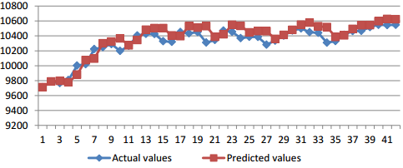
Used Cases
GA+FTS have been used to solve prediction problem in various fields. Implemented to reduce root mean square error and improve accuracy. Examples: Stock Market prediction Model. Enrollment Forecasting. Temperature Prediction Models. Tourism Demand Model. | Fig: Comparison of the predicted and expected value of Dow Jones Index (Year 2009)

Slide 4
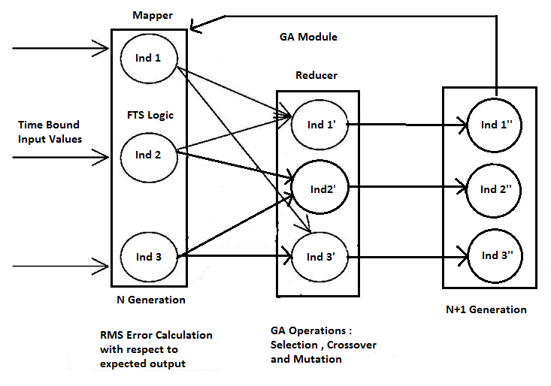
Architecture Overview

Slide 5
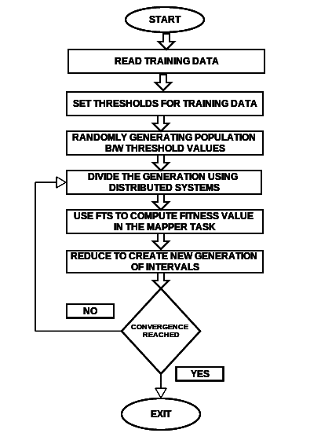
Flowchart Implementation
Creation of first generation of Individuals from the time bound data set.
Dividing this data in distributed manner so as to implement the data in MapReduce framework.
Mapper Function -> Apply FTS to calculate fitness of each individual.
Reducer Function -> Perform selection , crossover and mutation (GA operators) thereby creating an a new generation.

Slide 6
Algorithm
Step 1: After reading the data calculate the maximum and the minimum values and select thresholds so that we get Lmin and Lmax.
Step 2: Create the first generation of Genetic Algorithm which will be a set of individuals such that each will be a set of buckets which will lie in the range Lmin to Lmax.
Step 3: Create the division of the generation data which can be used in the MapReduce model. The mapper task will apply FTS and will make prediction for each individual and fitness value for each of them will be calculated.
Step 4: The reducer task will perform the selection, cross-over and mutation operations of GA based on the fitness value calculated by the mapper task. Thus, a new generation of individuals will be created.
Step 5: Repeat Steps 4 through 6 until the convergence point is not reached. Once reached terminate the process.

Slide 7
SUB-SYSTEM A : Genetic Algorithm (GA)
A set of computational methods that are inspired by evolutionary biology such as mutation, selection, inheritance and crossover that can be used to find solutions to optimization problem.
Genetic Algorithm mimics the evolutionary principle “ Survival of the Fittest”
Step 1: Generating random population of possible solution which corresponds to a single generation.
Step 3: Various GA operators are used such as SELECTION , CROSSOVER and MUTATION to improve the fitness quotient of each individual/generation.
Step 2: Fitness of every solution calculated and multiple solutions selected on basis of their fitness levels to reproduce a new generation.
Step 4: Process continues till there is no significant improvement in fitness level of a generation over previous one.

Slide 8
SUB-SYSTEM B : Fuzzy Time Series (FTS).
Dividing the input data of time bound event into even and equal length of intervals.
To fuzzify randomly generated set of chromosomes
Random selection of Chromosome/Individual that is a product of GA iteration.
Decide fuzzy enrollment pattern and also nth order fuzzy logic relationship.
Forecast best results on the basis of Root Mean Square Error (Fitness value parameter).

Slide 9
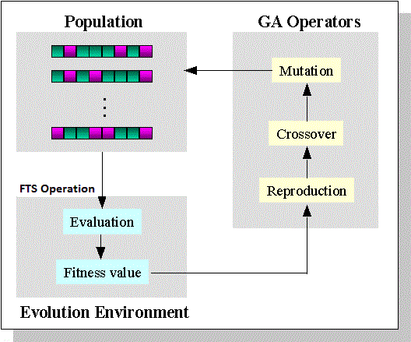
SUB-SYSTEM C: GA+FTS Hybrid Model
Basic Idea is to predict from a time bound data set by making use of FTS and GA.
FTS used as fitness calculator that is to calculate correctness of prediction for each individual as a function of Root Mean Square Error (RMS).
GA used to improve correctness for each generation over previous generation by making use of GA operators.
Process will terminate when a convergence point is reached.

Slide 10
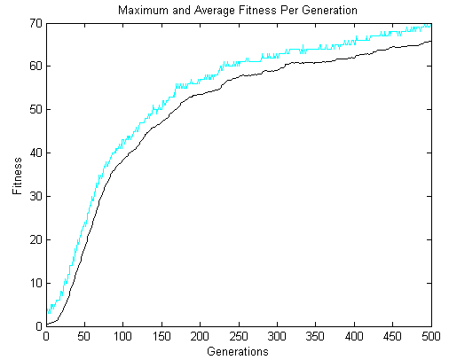
Potential Results
Running Time : The main result that we intend to achieve is significant drop of running time by implementing the same in distributed/parallel (Hadoop Framework) manner over normal sequential manner.
Correctness of our predictions : This will be done checking the RMS error function which will be minimum or there should be no significant change in the RMS value over 2 generations of result.
Possible comparison with other prediction models: This can be done so as to show the efficiency of our model in running time and over large data sets.

Slide 11

Related Work & Possibilities to Consider
Successful Implementation of GA-FTS prediction model but in a sequential manner.
Similar to GA, there are other evolutionary algorithms which have been developed on a parallel computational model
Use of advanced parallel computational framework such as Apache Giraph, YARN and so forth
Experimenting with the threshold parameters for GA and FTS to increase the fitness value
Analyzing the adaptability of GA operations to MapReduce paradigm
Dynamically retrieving data

